Slide 1
Design of a beta=1 double spoke cavity for the BES-CLS ICS light source
Feisi He^{1,2}, Haipeng Wang¹, Robert Rimmer¹, John Mammosser¹
1. Jefferson Lab. 2. Peking University
2012.3.8

Slide 2
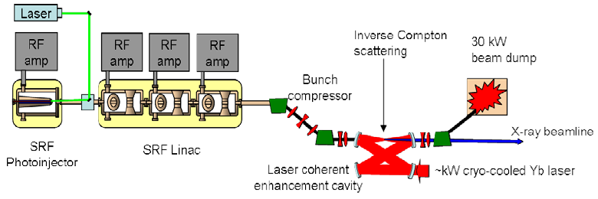
Requirement to the spoke caivty^{[1,2]}
CW Linac at 4 K for 1 mA electron, 4 MeV in, 22 MeV out (20MeV minimum). Linac length <= 4m
2 double-spoke cavities at 352MHz with β₀=1 in one cryomodule
Aperture diameter = 50 mm
Specification:
Vacc/cavity = 9 MV, Ep < 30 MV/m, Bp < 80 mT
G*R/Q as high as possible to reduce dynamic heat load
Ep/Vacc < 3.33 [m⁻¹], Bp/Vacc < 8.89 [mT/(MV)]

Slide 3
BES-CLS cavity design overview
Double spoke cavity at 352 MHz, with optimum beta of 1
Cavity length = 1241 mm
Cavity diameter = 601 mm
At Vacc = 9 MV, Ep = 29.8 MV/m, Bp = 52.4 mT
Notes:
Using model 20121401_3

Slide 4
EM properties of baseline (1)
L L L
Tricks to get higher G*R/Q:
C↓; L↑; B field broad distributed
Longer and thinner spoke central part
Smaller end-cone radius
Larger spoke base in beam transverse direction
Make field stronger in the end-gap (by making the re-entrant part deeper)
It is also easy to reduce Ep on the cost of a little bit heat load
C L C C

Slide 5
EM properties of baseline(2)
 | JLab prototype
Aperture diameter[mm] | 50
Lcavity (end-to-end) [mm] | 1241
Cavity diameter [mm] | 601.1
Ep/Ea | 4.23
Bp/Ea [mT/(MV/m)] | 7.43
Geometry factor [Ω] | 191.4
Ra/Q [Ω] | 727.4
Ra*Rs (=G*Ra/Q) [Ω²] | 1.392 x 10⁵
Va@Ep30MV/m [MV] | 9.06
Q₀ at 4.5 K (Rbcs=48nΩ, and assume Rres=20nΩ) | 2.8 x 10⁹
Power loss at Va=9MV (Rs=68nΩ) [W] | 39.6
Leff = 1.5*β₀*λ = 1276.8 [mm];
Va = V₀*TTF(β₀); Ea = Va/Leff = 6.6 MV/m at Va of 8.4 MV
Notes:
Using model 20121401_3

Slide 6
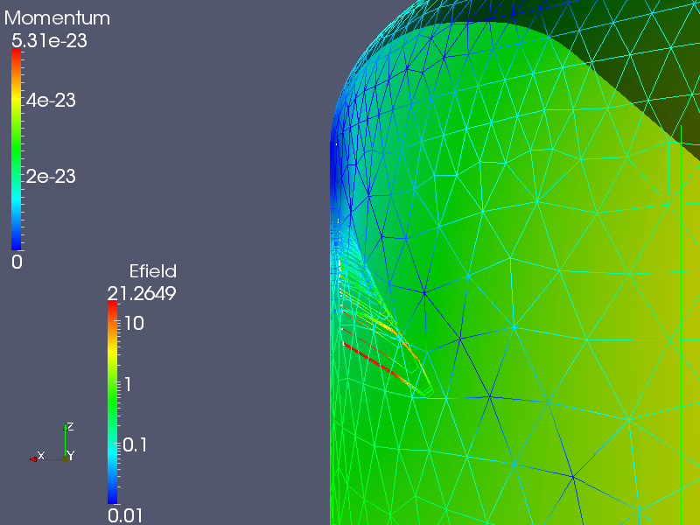
MP analysis of baseline design
Walking MP trapped
1: 0.7-2.5 MV
2: 1-2.6 MV
6: 7.6-9 MV
3: 1.3-
3.8 MV
5: 6.1-
9 MV
4: 0.65-4.5 MV
Unstable walking MP
Zone 1
Walking MP
2nd order
Zone 2
Walking MP
2nd order
Zone 3 & 4
Walking MP
1st order
Zone 5 & 6
Two points
1st order

Slide 7
Prediction of MP level
Above 6 MV is soft barrier
0.65 – 4.5 MV is wide barrier of walking MP. Experiment on prototype is needed to indentify whether it is hard to process. Besides, some levels are especially dangerous:
0.8 MV in zone 1, particles survive for > 150 RF periods with ~200 eV (6th order)
1-1.2 MV in zone 2, particles survive for > 150 RF periods with 50~250 eV (3rd order)
0.65-1.3 MV in zone4, stable one point MP (trapped) with 50~120 eV (3rd order)
So, 0.6-1.3 MV might be strong MP barrier
Plasma cleaning may be used to process away the MP
1: 0.7-2.5 MV
2: 1-2.6 MV
Surviving MP after 20 RF periods
6: 7.6-9 MV
3: 1.3-
3.8 MV
5: 6.1-
9 MV
4: 0.65-4.5 MV

Slide 8
Field flatness is not the reason for wide walking MP barrier
E field in end cell 36% stronger
than in middle cell
Flat E field
4: 1.4-5.3 MV
4: 1.3-4.4 MV
1
5: 4.4-7 MV
5: 3.8-6.5 MV
3: 1-3.4 MV
3: 1.8-4.4 MV
6: >8 MV
3
4
2: 0.7-1.8 MV
2: 0.8-1.8 MV
1: 0.7-2.2 MV
1: 0.8-1.8 MV
2

Slide 9
Increase the blending radius
Our experience on a β=0.5 cavity for ESS shows that, rounder edge may help to reduce the impact energy of the 2 points, 1st order MP.
Initial result is promising: it is free of stable MP in dangerous impact energy range with large blending radius
2: ~1.4 MV
1: 1.4-1.8 MV
3: 1.8-4.6 MV

Slide 10
Power coupling to the cavity
Beam: 1 mA, 9 MV.
With frequency fluctuation δf,
Qe may be as low as 7 *10⁶, depending on level of micro-phonics
For VTA test, Qe may be 3 *10⁹, and through the beam pipe
Lante [mm] | Dport [mm] | Impendance [Ω] | Qe
-5 | 75.743 | 50 | 9.26E+06
0 | 75.743 | 50 | 5.45E+06
0 | 114.80 | 75 | 4.60E+06
-10 | 19.89 | 50 | 3.96E+10
δf = 20 Hz
δf = 15 Hz
δf = 10 Hz
δf = 5 Hz
δf = 0

Slide 11
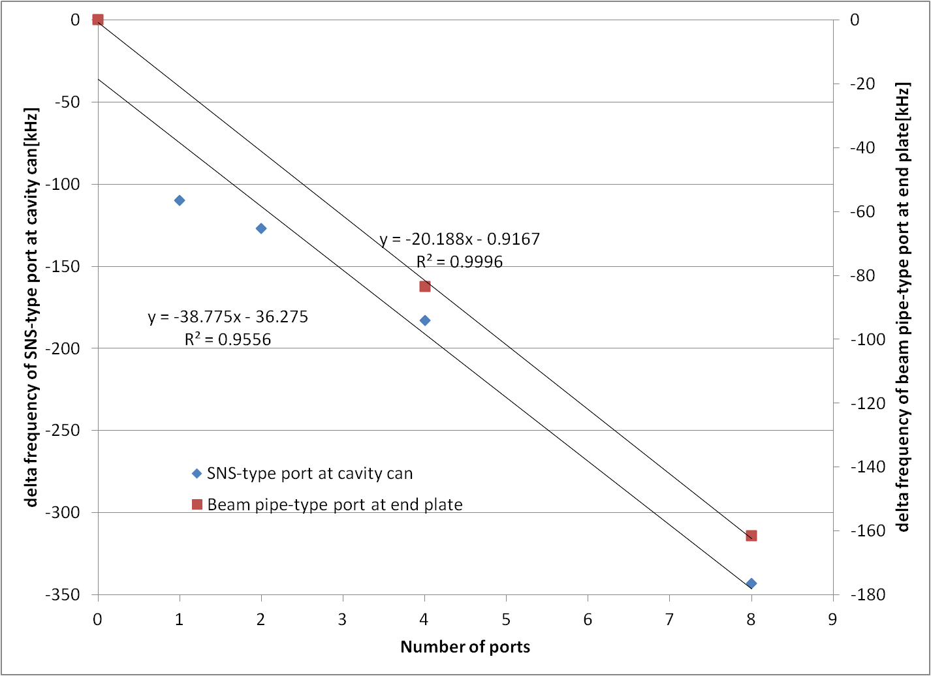
Effect of ports on frequency
Omega3p simulation result:
Port at coupling port position: -40 kHz/port
Port at end plane: -20 kHz/port (perturbation method -20 kHz/port)
Perturbation method^{[3]} for circular hole is:
Port at coupling port position:
-42 kHz/port
Port at end plane: -20 kHz/port
 | Lport [mm] | E at port at 9MV [MV/m] | B at port at 9MV [mT] | B at flange at 9MV [mT]
SNS-type | 50 | 1.7 | 40 | 3.8
 | 70 |  |  | 1.4
End plate | 50 | 6.4 | 54 | 1.5
 | 70 |  |  | 0.3

Slide 12
Effect of etching on frequency
Perturbation method for uniform surface removal:
Define dL>0 for moving towards inside the cavity
a = 3.0 [m⁻¹] for the spoke cavity (by HFSS)
H field dominates
ai can be seen as the surface
local frequency sensitivity,
and is a reference for tuning
and stiffening ring design
By offsetting surface in omega3p gives -152 kHz at 150 μm
Etching depth [μm] | df/f | df [kHz]
10 | -3.02E-05 | -10.6 ± 0.4
50 | -1.51E-04 | -53 ± 2
100 | -3.02E-04 | -106 ± 4
150 | -4.53E-04 | -160 ± 5
200 | -6.04E-04 | -213 ± 7

Slide 13
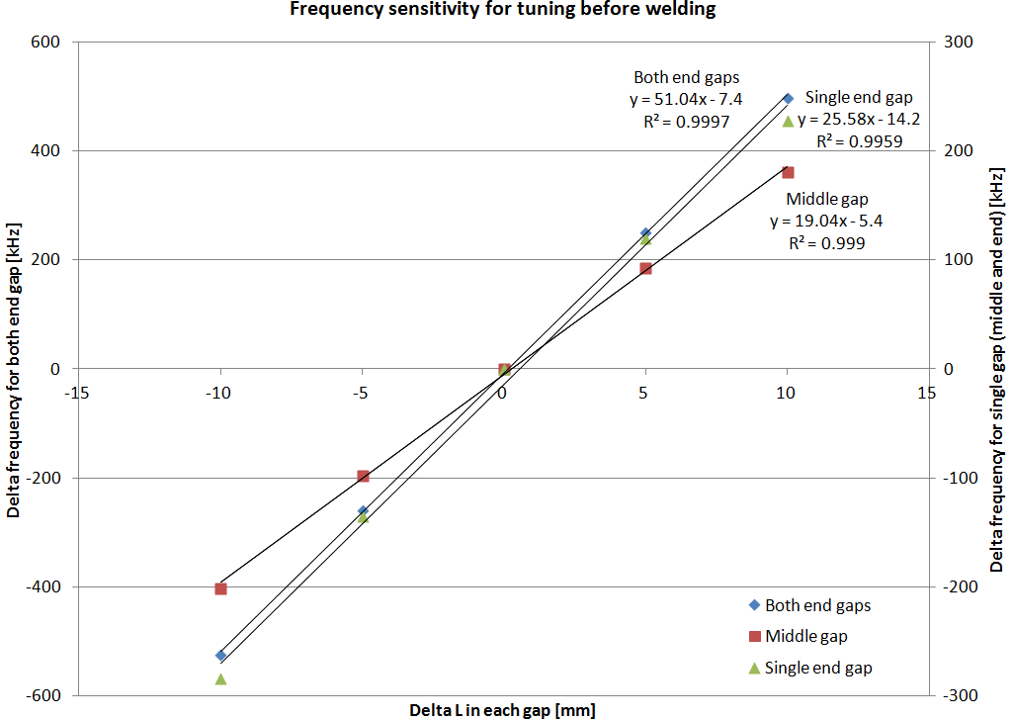
Estimation of frequency tuning before welding
Control the diameter of the cavity is important
Possible to tune the frequency in the fabrication process by cutting the length of acceleration gap
Compare with sensitivity of
cavity can diameter:
ΔD 1 [mm] ~ Δf 600 [kHz]

Slide 14
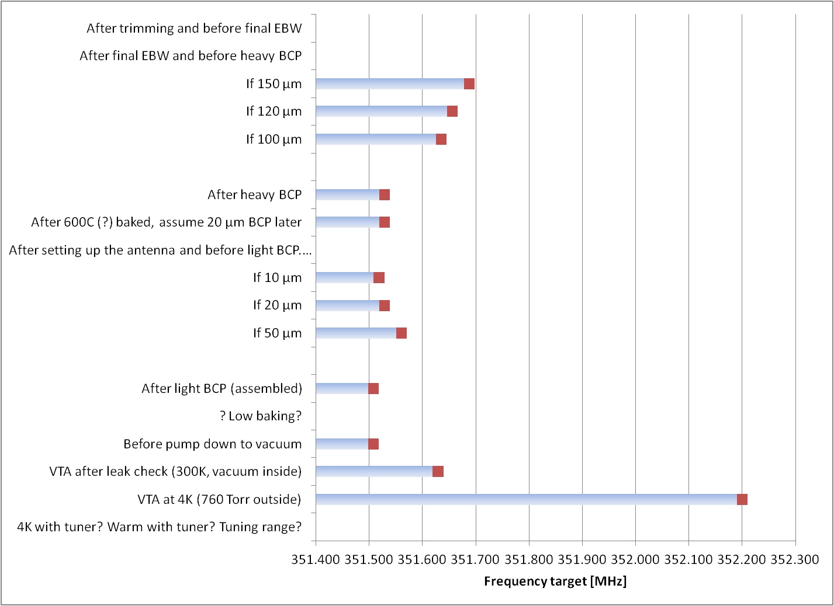
Initial frequency recipe
Prototype is needed to learn the frequency recipe for exact frequency control

Slide 15
Mechanical analysis is in progress
Methods to reduce stress on cavity
Switch spoke shape from race-track to elliptical
Increase blending radius
Stiff supporters may be needed for VTA test
MP analysis is promising: no stable MP at all
Lots of work still needed
 | Ep at Va=9 MV [MV/m] | Bp at Va=9 MV [mT] | G [Ω] | Ra/Q [Ω] | G*R/Q [Ω²]
Original | 29.8 | 52.4 | 191.4 | 727.4 | 1.392x10⁵
Modified | 31.7 | 49.3 | 196.7 | 745.5 | 1.467x10⁵

Slide 16
Single spoke version for prototyping
Keep all the geometries the same as double spoke model (diameter, gap length, end cones, spoke, blendings).
Cavity length = 849 mm
Cavity diameter = 601.1 mm
Lcavity [mm] | Code | Frequency [MHz] | β₀ | G [Ω] | R/Q [Ω] | G*R/Q [Ω^2] | Ep/(Va/Lca) | Bp/(Va/Lca) [mT/(MV/m)]
849 | CST | 352.14 | 1 | 199 | 524 | 1.04E+05 | 3.48 | 6.36

Slide 17
MP of the single spoke version
An initial study was done for single spoke with 849 mm length
The two types of MP, walking and stable two points, also exist in the single spoke, and the barrier levels looks pretty like the case in double spoke. Though, it has stronger stable MP than the double spoke in high field level.

Slide 18
Cost estimation of linac: assumptions
Capital:
4.4K Cryo-plant of 400W with $5M (including injector); $8M if 2K cryo-plant
RF power supply and distribution of $60 / W
Cryomodule: $200k
Cavity: Nb weight based plus frequency based, $270k/Spoke cavity
Capital of alternative options:
Superconducting elliptical cavity, $2k/kg + end group $30k*1.3/f0[GHz], that is $90k for 1.3G 9cell cavity
Normal conducting standing wave cavity, $10M for 1MW RF power supply and distribution, $50k/cavity

Slide 19
Cost estimation of linac: assumptions (2)
Operational:
Working 8 hours/day, 5 days/week, 52 weeks/year
LHe static loss is continuous, where part proportional to number of cavities, and part proportional to 1/f0
900W/1W cooling efficiency at 4K, 3400W/1W at 2K^{[4]}
80W on LN shielding (300 liters LN/week), and 10₵/L
20nΩ residual resistance to estimate dynamic heat load
50% efficiency of RF power supply
7₵ / kWh electric power

Slide 20
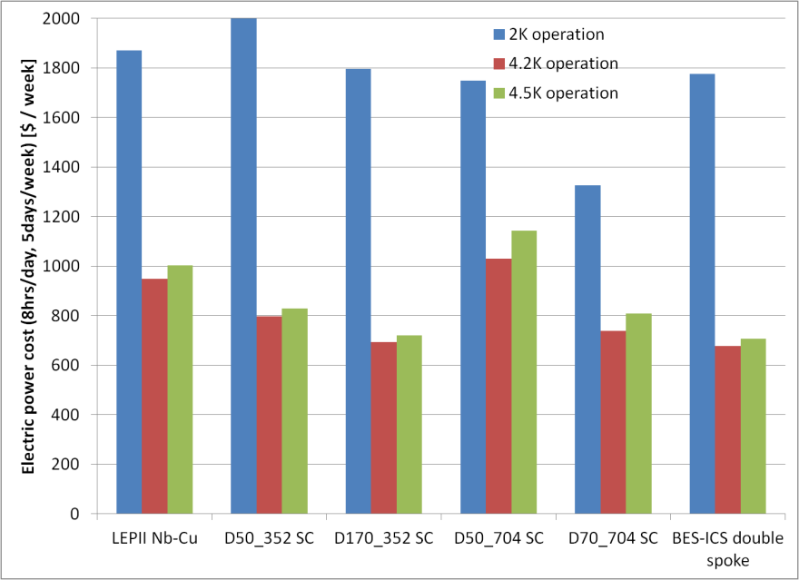
Linca cost comparison
By fitting linac in 4 m length and minimizing cryogenic heat load, the cost of superconducting and normal conducting elliptical cavities are compared to the spoke:
2K operation is more expensive in all cases, since static heat load plays important role, and cooling efficiency drops
704 MHz SC elliptical cavities cost a little more to operate due to higher surface resistance; 352MHz elliptical cavities are competitive in performance but bigger in diameter.
NC linac is longer than 10 m with
dynamic loss less than 1MW
Capital cost dominates in all cases
Note: rough estimation;
Working in progress, not conclusive

Slide 21
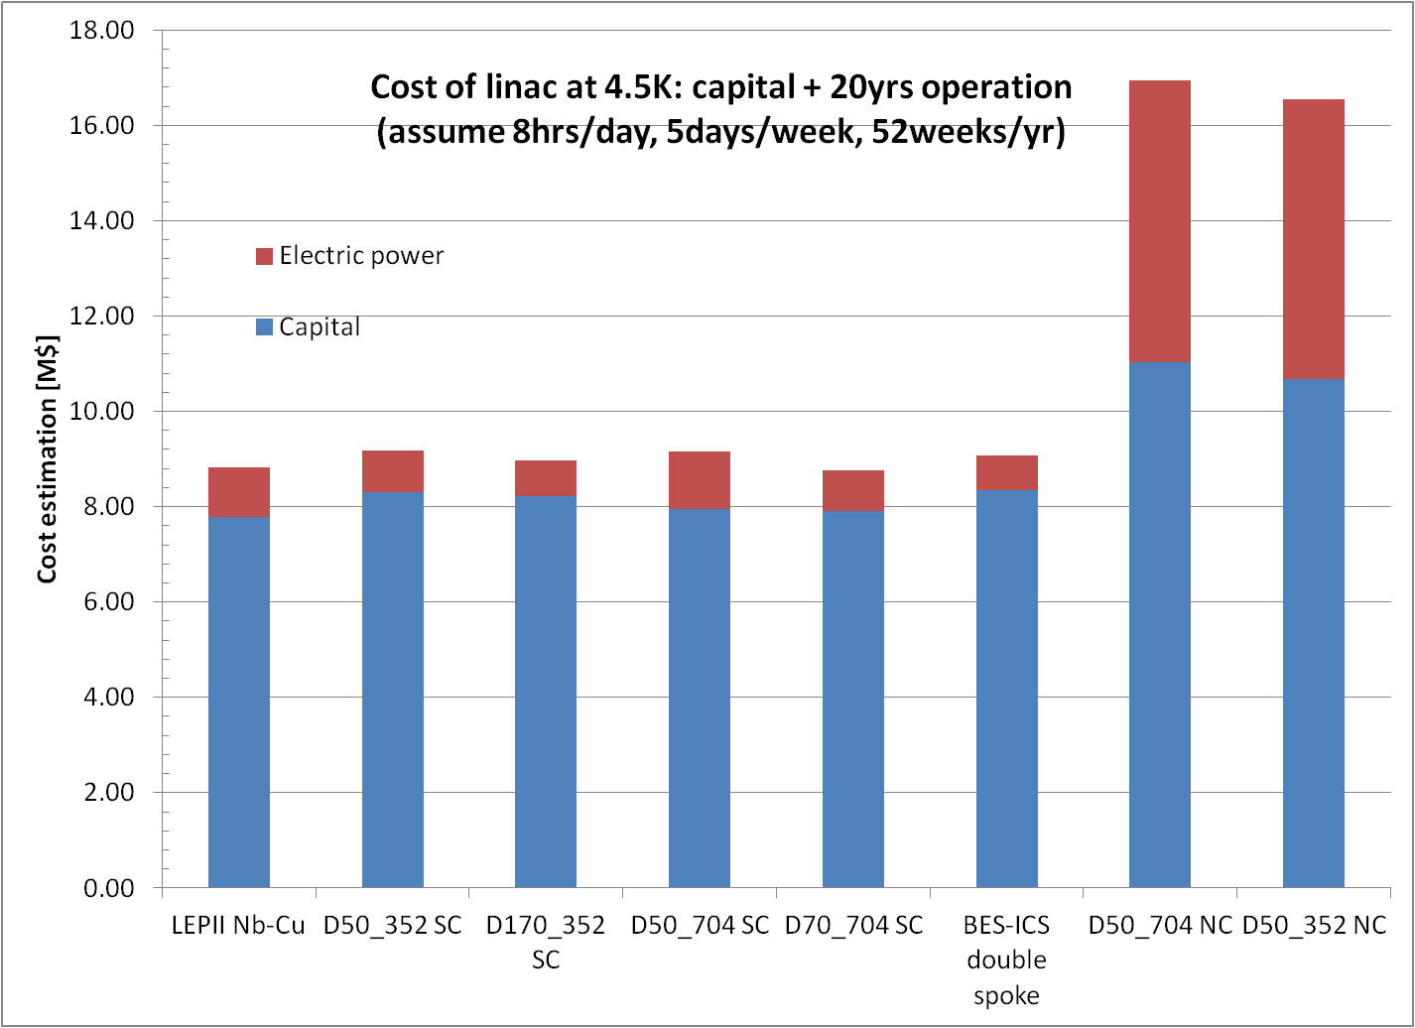
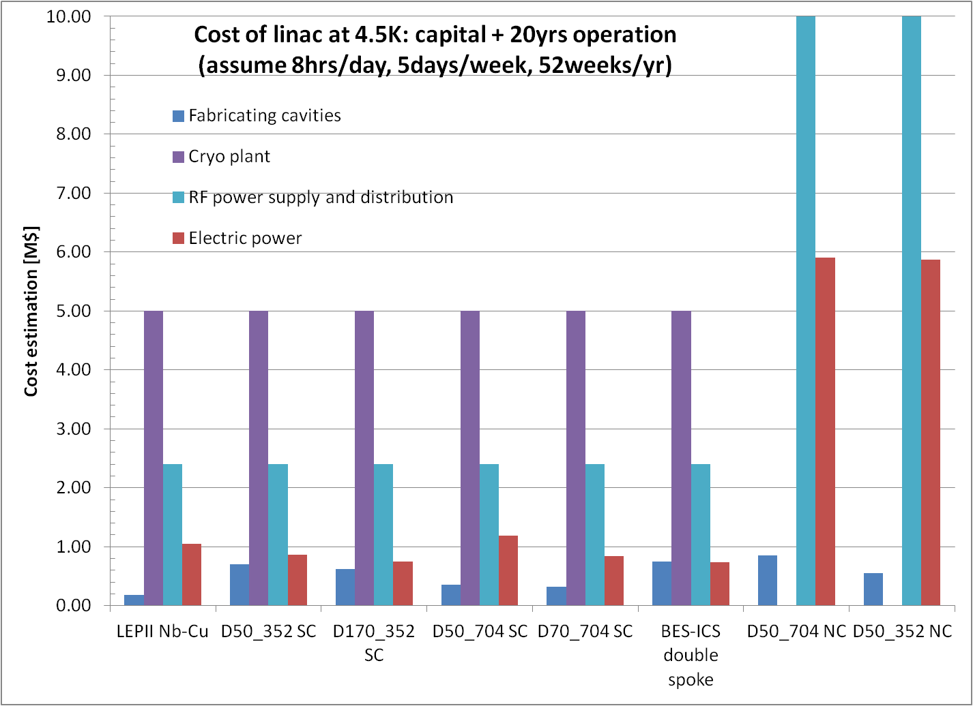
Linac cost comparison (2)
Note:
LEPII cavity is only for reference, since their dynamic loss per cavity is too high for this application
Man power for operation is not included.
At JLab consumed LHe and LN is ~0.4*cryo-system electric power cost^{[4]}
Rough estimation; working in progress, not conclusive

Slide 22
Acknowledgements
I would like to thank Shirley Yang, Gary Cheng, James Henry, Mircea Stirbet at Jlab, and William Graves at MIT for their help
Thank you for your attention

Slide 23
Below are supporting materials

Slide 24
Linac comparison
SC cavities at 4.5K
Name ID | Frequency | Iris D | Equator D | cell no. | Cavity weight wall 3mm | Cavity active length | Vacc per cavity | Cavity no. | Ep on operation | Linac length (+0.5 m * Nca) | Dynamic loss per cavity | Dynamic loss of full 21 MV | Capital cost | Electric power cost | Electric power cost | Estimated static heat load | Peak LHe heat load | Peak electric power
 | MHz | mm | mm |  | kg | mm | MV |  | MV/m | m | W | W | M$ | $/week | M$/20yrs | W | W | kW
LEPII Nb-Cu | 352.2 | 241 | 753 | 4 | 132 | 1702 | 18.0 | 1 | 24.3 | 2.2 | 214.3 | 214.3 | 7.8 | 1004 | 1.05 | 31 | 246 | 257
D50_352 SC | 352.0 | 50 | 709 | 1 | 33 | 426 | 4.5 | 4 | 26.7 | 3.7 | 23.7 | 94.9 | 8.3 | 830 | 0.87 | 43 | 138 | 160
D170_352 SC | 352.2 | 170 | 730 | 3 | 99 | 1277 | 9.0 | 2 | 16.5 | 3.6 | 42.8 | 85.5 | 8.2 | 721 | 0.75 | 35 | 121 | 145
D50_704 SC | 704.0 | 50 | 355 | 1 | 8 | 213 | 3.6 | 5 | 40.7 | 3.6 | 52.1 | 260.4 | 8.0 | 1144 | 1.19 | 34 | 294 | 301
D70_704 SC | 704.0 | 70 | 355 | 3 | 25 | 639 | 6.0 | 3 | 22.1 | 3.4 | 53.6 | 160.9 | 7.9 | 809 | 0.84 | 26 | 187 | 204
BES-ICS double spoke | 352.2 | 50 | 599 | 3 | 111 | 1277 | 9.0 | 2 | 28.2 | 3.6 | 39.7 | 79.3 | 8.3 | 706 | 0.74 | 35 | 115 | 139
Normal conducting elliptical cavity (standing wave, CW) with dynamic loss <= 1 MW of full 21 MV
Name ID | Frequency | Iris D | Equator D | cell no. |  | Cavity active length | Vacc per cavity | Cavity no. | Ep on operation | Linac length (+0.3m*Nca) | Dynamic loss per cavity | Dynamic loss of full 21 MV | Capital cost | Operational cost | Electric power cost |  |  | Peak electric power
 | MHz | mm | mm |  |  | mm | MV |  | MV/m | m | kW | kW | M$ | $/week | M$/20yrs |  |  | kW
D50_704 NC | 704.0 | 50 | 355 | 1 |  | 213 | 3.0 | 17 | 12.0 | 10.4 | 58.4 | 993.1 | 11.0 | 5662 | 5.906 |  |  | 2022
D50_352 NC | 352.0 | 50 | 709 | 1 |  | 426 | 4.5 | 11 | 18.5 | 9.1 | 89.8 | 987.3 | 10.7 | 5629 | 5.871 |  |  | 2011
Assumptions: Linac length <= 4m; $2k/kg and additional $30k*1.3/f0[GHz] (end-group) per cavity for elliptical Nb cavity (plus coupler and tuner), that is $90k for 1.3G 9cell cavity; $270k/cavity for spoke cavity; 1/5 per weight price and $20 for Nb coated Cu cavity; $50k per copper cavity; $60 / W for buying small scale RF power supply, $10 / W for large scale (including load, circulator, power supply and so on); $1M for 4K cryogenic system of <100W, $5M for 400W; $8M for 2K cryogenic system; 200k for the overall one cryomodule; 7₵ / kWh electric power; 50% efficiency of RF power supply; 900W input power per 1W cooling capacity at 4K, 3400W at 2K; 20nΩ residual resistance for SC cavities; working 8 hours per day, 5days per week, 52 weeks per year; part of static loss proportional to number of cavity, and part proportional to 1/f0, according to SNS's data; 80W on LN shielding, which is 300 liters LN/week, and 10₵/liter price

Slide 25
Cavity comparison
Name ID | Frequency | β=v/c | Iris r/λ | Iris D | Equator R/λ | Equator D | cell no. | Cavity weight wall3mm | Cavity active length | R/Q / length | G | R/Q*G / cavity | Epeak/Eacc | Bpeak/Eacc | kcc | N²/(βkcc) | Rs@4.2K | P/(Vacc^2)@4.2K | Max heat flux/Va^2 | Rs@4.5K | P/(Vacc^2)@4.5K | Max heat flux/Va^2
 | MHz |  |  | mm |  | mm |  | kg | mm | Ω / m | W | [W² / Cav] |  | mT/(MV/m) | % |  | nΩ | W/(MV^2) | mW/cm^2/MV^2 | nΩ | W/(MV^2) | mW/cm^2/MV^2
LEPII Nb-Cu | 352.2 | 1 | 0.142 | 241 | 0.442 | 753 | 4 | 132 | 1702 | 273 | 286 | 1.33E+05 | 2.30 | 3.90 | 1.76 | 909 | 79 | 0.59 | 0.0131 | 88 | 0.66 | 0.0146
D50_352 SC | 352 | 1 | 0.029 | 50 | 0.416 | 709 | 1 | 33 | 426 | 512 | 267 | 5.83E+04 | 2.52 | 3.30 |  |  | 59 | 1.01 | 0.1122 | 68 | 1.17 | 0.1297
D170_352 SC | 352.2 | 1 | 0.100 | 170 | 0.429 | 730 | 3 | 99 | 1277 | 358 | 283 | 1.29E+05 | 2.34 | 3.86 | 0.64 | 1406 | 59 | 0.46 | 0.0171 | 68 | 0.53 | 0.0198
D50_704 SC | 704 | 1 | 0.059 | 50 | 0.417 | 355 | 1 | 8 | 213 | 933 | 267 | 5.30E+04 | 2.41 | 3.46 | 0.01 | 7436 | 176 | 3.32 | 1.4728 | 213 | 4.02 | 1.7803
D70_704 SC | 704 | 1 | 0.082 | 70 | 0.416 | 355 | 3 | 25 | 639 | 796 | 281 | 1.43E+05 | 2.35 | 3.55 | 0.34 | 2623 | 176 | 1.23 | 0.1723 | 213 | 1.49 | 0.2082
D90_704 SC | 704 | 1 | 0.106 | 90 | 0.415 | 353 | 5 | 41 | 1065 | 713 | 283 | 2.15E+05 | 2.59 | 3.74 | 0.89 | 2802 | 176 | 0.82 | 0.0690 | 213 | 0.99 | 0.0834
BES-ICS double spoke | 352.2 | 1 | 0.029 | 50 | 0.352 | 599 | 3 | 111 | 1277 | 572 | 191 | 1.39E+05 | 4.39 | 6.66 |  |  | 59 | 0.42 | 0.0509 | 68 | 0.49 | 0.0588
 |  |  |  |  |  |  |  |  |  |  |  |  |  |  |  |  | Rs copper | P/(Vacc^2) | Max heat flux/Va^2
 |  |  |  |  |  |  |  |  |  |  |  |  |  |  |  |  | mΩ | kW/(MV^2) | W/cm^2/MV^2
D50_704 NC | 704 | 1 | 0.059 | 50 | 0.417 | 355 | 1 |  | 213 | 933 | 267 | 5.30E+04 | 2.41 | 3.46 | 0.01 | 7436 | 2.8 | 52 | 23.0877
D50_352 NC | 352 | 1 | 0.029 | 50 | 0.416 | 709 | 1 |  | 426 | 512 | 267 | 5.83E+04 | 2.52 | 3.30 |  |  | 2.0 | 34 | 3.7104
Assume 20 nΩ Rres for SC cavities

Slide 26
LEPII cavity performance^{[5,6]}
At 6MV/m and 4.5K, Rs of Nb-Cu cavity ~ 88nΩ, Nb(RRR40) ~ 140nΩ. Rbcs ~ 50 nΩ
Strong Q drop; no high baking and HPR

Slide 27
MP of 352 MHz elliptical cavity
Diris = 170mm, 0.56 MHz between 2π/3 and π mode
Two points, 1st order stable MP at equator zone, with impact energy < 35 eV, at energy gain > 7.8 MV
It should be easy to process away, if ever occurs

Slide 28
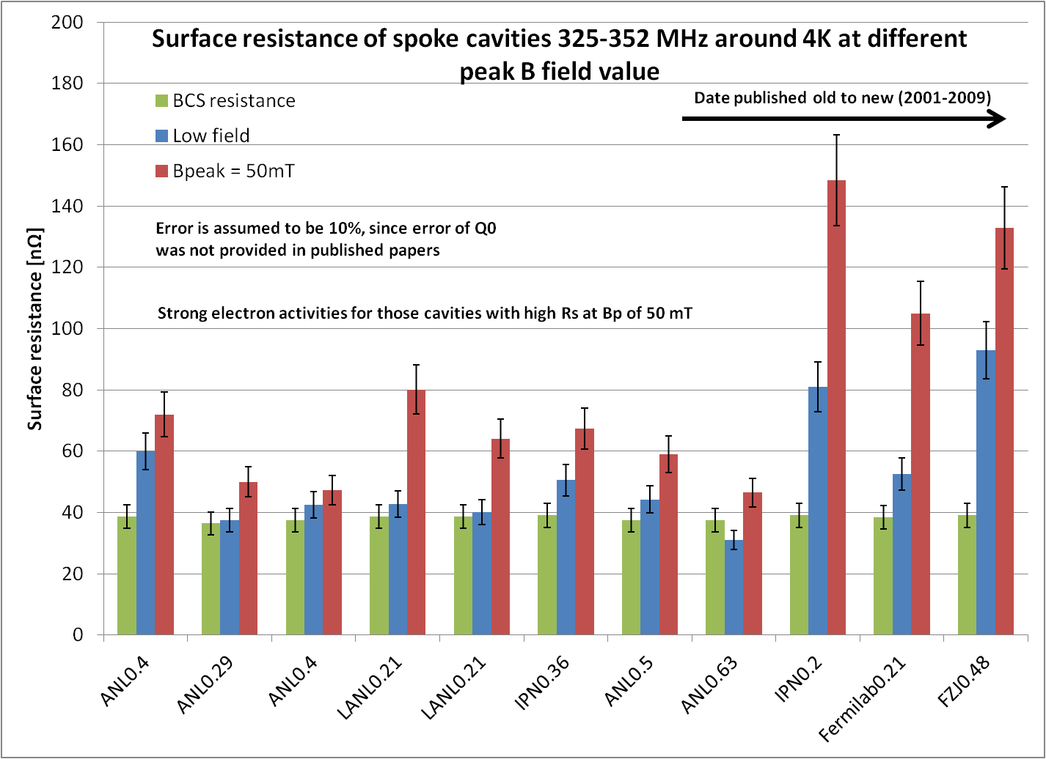
Is Rres 20 nΩ reasonable for spoke?^{[7-15]}
Many spoke cavities are w/o FE or MP at Bp~50mT
As low as <10 nΩ Rres at low field is common
Worst estimation of Rres may be 30 nΩ

Slide 29
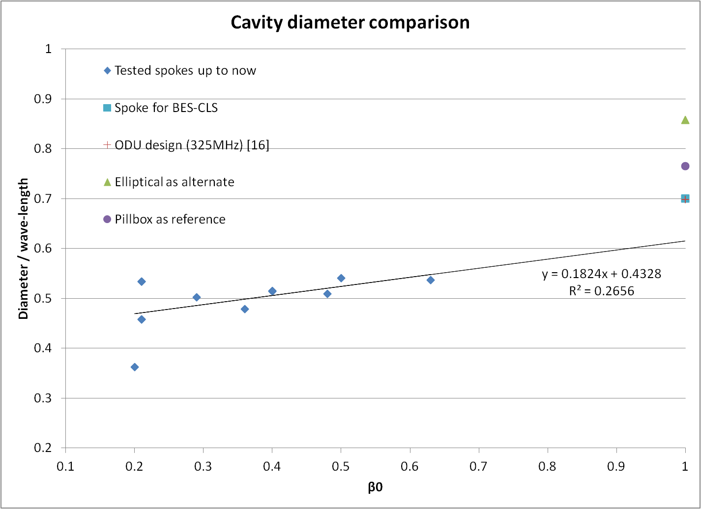
Diameter comparison
There is a trend of increased diameter with β, since capacitance in the gaps is reduced, so inductance has to be larger to tune frequency back.

Slide 30
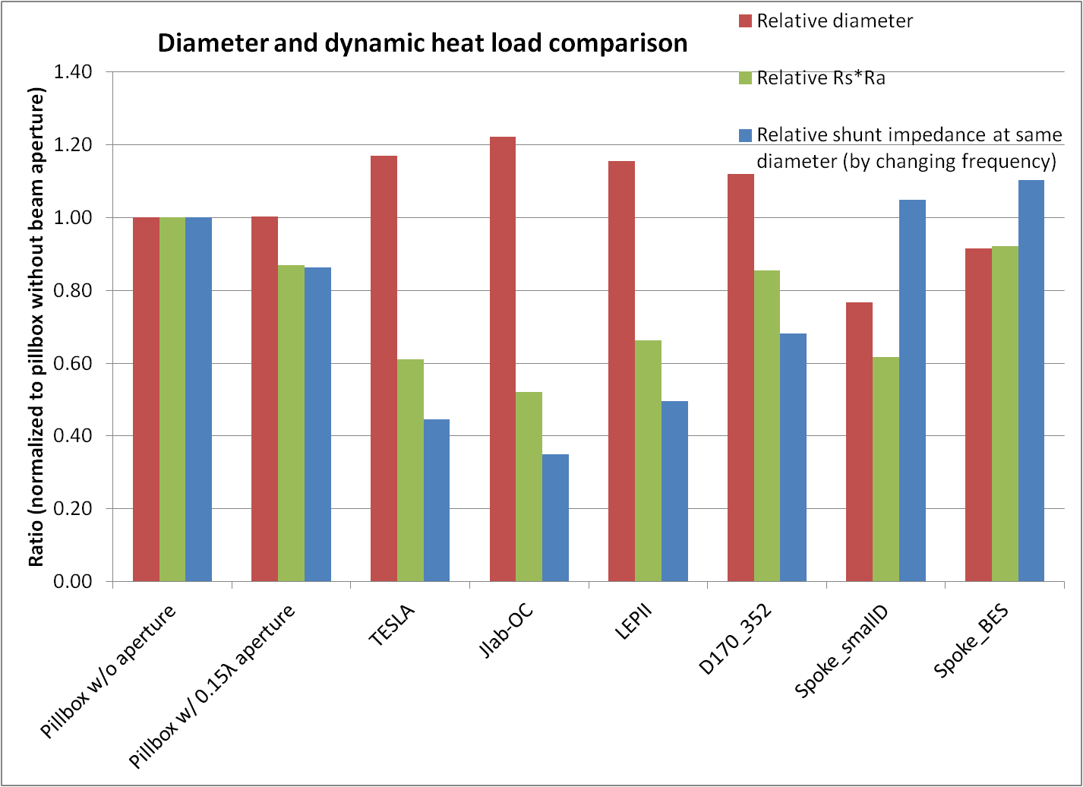
Diameter and dynamic load comparison
Increasing G*R/Q at the cost of diameter is the right direction to optimize a spoke cavity

Slide 31
Cryo-system efficiency^{[4]}

Slide 32
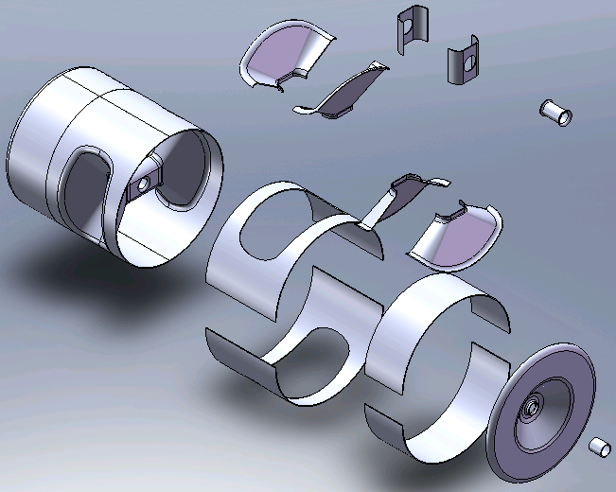
Cavity geometry (all in mm)
Dbeamp | Distance of beam pipe edge to central plane | 620.5
Dspokc | Distance of spoke central edge to central plane | 100.0
Hconeb | Height of beampipe cone | 73.0
Lend_e | Cavity end to end distance | 1241.0
Lirisi | Cavity iris to iris distance | 1095.0
Lspok | Spoke to spoke distance | 392.0
Rbeama | Radius of beam aperture | 25.0
Rbeamp | Radius of beam pipe | 25.0
Rblenba | Radius of beam aperture blending | 10.0
Rblenbp | Radius of beam pipe blending | 10.0
Rbleno | Radius of all other blending | 35.0
Rblens | Radius of spoke blending | 20.0
Rconebb | Radius of beampipe cone base | 160.0
Rconebt | Radius of beampipe cone top | 60.0
Rout | Radius of outer cylinder | 300.55
Rspokbl | Longitudinal radius of spoke base | 115.0
Rspokbt | Transverse radius of spoke base | 370.0
Rspokcl | Longitudinal radius of spoke center | 54.0
Rspokct | Transverse radius of spoke center | 69.0
Wspokb | Width of the spoke base race-track | 260.0
Wspokc | Width of the spoke center race-track | 38.0
Illustration of possible way to fabricate
the cavity, based on Larry’s plan

Slide 33
Coupling port and service port
Position | Lante [mm] | Rante [mm] | Lport [mm] | Rport [mm] | Dport [mm] | Rblenp [mm] | Qe | B on flange at 8.4MV [mT]
90 Degree | -20 | 10.85 | 50 | 25 | 400 | 15 | 2.08E+09 | 0.76
 | 0 | 10.85 | 50 | 25 | 400 | 15 | 6.70E+07 | 0.77
 | 0 | 10.85 | 70 | 25 | 370 | 15 | 2.13E+07 | 0.16
 | 3 | 10.85 | 50 | 25 | 370 | 15 | 1.39E+07 | 0.70
45 Degree | -20 | 10.85 | 50 | 25 | 400 | 15 | 1.40E+09 | 1.12
 | 0 | 10.85 | 50 | 25 | 400 | 15 | 4.51E+07 | 1.11
 | 0 | 10.85 | 50 | 25 | 500 | 15 | 2.17E+07 | 1.08
 | 10 | 10.85 | 50 | 25 | 500 | 15 | 5.81E+06 | 1.09
 | 0 | 17.36 | 70 | 40 | 500 | 15 | 3.74E+06 | 1.51
45 Degree with respect to the SNS coupler port | 0 | 16.45 | 70 | 37.87 | 450 | 15 | 5.45E+06 | 1.33
 | -5 | 16.45 | 70 | 37.87 | 450 | 15 | 9.26E+06 | 1.26
 | 0 | 16.45 | 70 | 37.87 | 500 | 15 | 4.60E+06 | 1.28
 | 0 | 16.45 | 70 | 57.4 | 450 | 15 | 1.48E+06 | 3.72
0 Degree | 0 | 10.85 | 50 | 25 | 400 | 15 | 8.24E+06 | 1.17
Middle | 0 | 10.85 | 50 | 25 | 0 | 15 | 7.08E+06 | 0.55

Slide 34
References
J. Mammosser, “ICS proposal”, September 2010.
“MIT Inverse Compton Source Technical Specifications”, working draft
J. Gao, “Analytical formulas for the resonant frequency changes due to opening apertures on cavity walls,” NIM.A, 311, no. 3 (January 15, 1992): 437-443.
JLab cryo-group, “Cryogenics at JLab”, cryo tutorial at JLab at Jan 25, 2011
D. Boussard, “Performance of the LEP2 SRF System.”, PAC97
C. Arnaud, “Status Report on Superconducting Nb Cavities for LEP.”, SRF1989
M. Kelly, et al, “Cold Tests of a Spoke Cavity Prototype for RIA,” in PAC01, 2001.
T. Tajima et al, “Evaluation and Testing of a Low-[beta] Spoke Resonator,” in PAC01, 2001.

Slide 35
References (2)
M. Kelly, et al, “Cold Tests of the RIA Two-Cell Spoke Cavity,” in SRF2003, 2003.
T. Tajima et al, “Results of Two LANL Beta = 0.175, 350-MHz, 2-Gap Spoke Cavities,” in PAC03, 2003.
G. Olry et al, "Development of SRF Spoke Cavities for Low and Intermediate Energy Ion Linacs", in SRF2003
Michael Kelly, “Status of Superconducting Spoke Cavity Development,” in SRF2007, 2007.
S. Bousson et al, “Spoke Cavity Developments for the EURISOL Driver,” in Linac06, 2006.
L. Ristori et al, “Design, Fabrication and Testing of Single Spoke Resonators at Fermilab,” in SRF2009, 2009.
E. Zaplatin et al, “FZJ HIPPI SC Triple-Spoke Cavity,” in PAC09, 2009.
J. Delayen et al, “Design of Low-Frequency Superconducting Spoke Cavities for High-Velocity Applications.” In IPAC’11, 2011.

